Slide 1
lynn@wicys.org
TWITTER: @lynn_dohm
wicys.org

Slide 2
5.5K+
members

Slide 5
WiCyS MISSION: Help build a strong gender-diverse cybersecurity workforce by facilitating… RECRUITMENT RETENTION ADVANCEMENT for women in the field

Slide 9
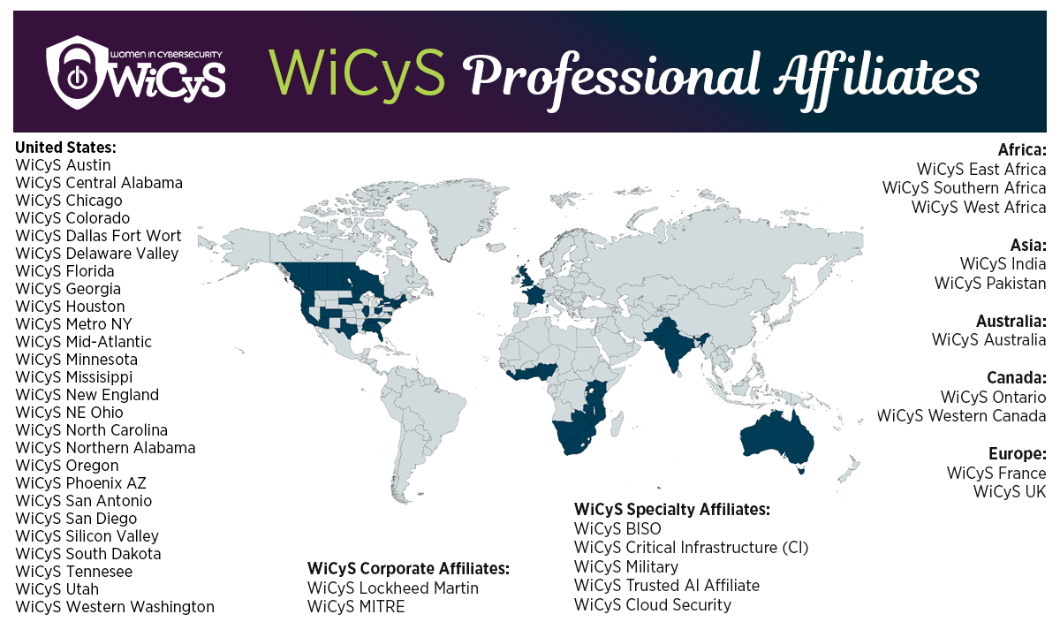

Slide 11
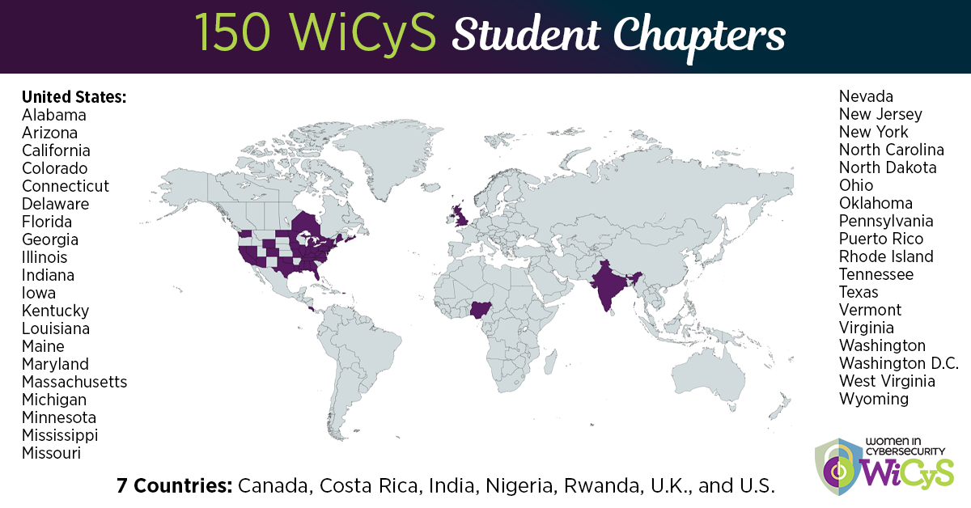

Slide 12
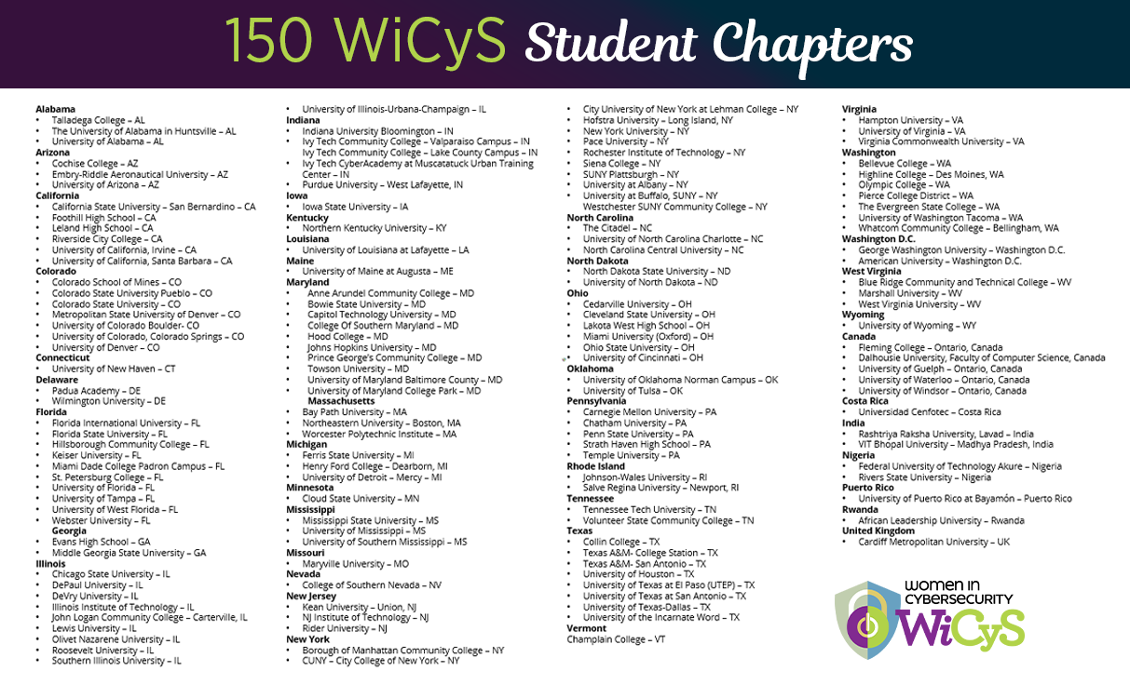

Slide 13
WiCyS Global Student Chapter Initiative
made possible by Microsoft Philanthropies

Slide 14
BENEFITS Find your Wi-Sisters; Build Something Together
Build a supportive community
Join a global student chapter leadership network
Create lifelong relationships
Engage with other women in cybersecurity Non-Governmental Organizations
Learn foundational (and advanced) cyber skills
Network with some of the World’s Biggest Cybersecurity Players
Own your leadership
Discover new strengths
Lift yourself, lift others
Internship Opportunities
Participate in team competitions (CTFs, Policy Hackathons)
Explore cyber pathways and career options

Slide 15
THINGS TO DO:
Host or build an inclusive CTF, hackathon, cyber competition, etc.
Participate in a cyber law/ policy writing competition
Cyber movie night
Learn and Teach Cyber Concepts - What is Ransomware, etc.
Cyber Trivia Night
Technical Workshops - ex; how to use wireshark
Host a career development panel with industry professionals
Speed Networking Event
Resume Workshop
Mock Interview Practice
Give Visibility and Celebrate Unique Voices and Contributions

Slide 16
WiCyS STUDENT CHAPTERS
Student chapters receive $500 seed funding and yearly ongoing funding
Student chapter president guaranteed a WiCyS conference scholarship
Faculty advisors prioritized for WiCyS conference faculty grants
Faculty advisors receive free WiCyS global membership
Student chapter leaders obtain access to global leadership community
WiCyS provides buttons/stickers for chapter events
No chapter-specific fees
WiCyS branding logo, website recognition, member badges, etc.

Slide 18
REQUIREMENTS:
Chapter president must be a WiCyS global member (Microsoft Philanthropies offers each chapter five global memberships)
Chapter Leadership must all be students that identify as women
Faculty advisor Is WiCyS member (membership provided)
Commitment to diversity and inclusion (anyone on campus should be able to join the chapter to support ongoing advocacy and allyship)

Slide 19
EXPECTATIONS:
Promote the recruitment, retention and advancement of women (allies/advocates) across campus
Run monthly chapter meetings
Attend monthly global chapter leadership meetings
Submit yearly chapter report on activities, participation, challenges, and finances

Slide 20
LEARN MORE ABOUT STUDENT CHAPTERS:
https://www.wicys.org/initiatives/student-chapters/
wicys.org

