Slide 1
Women in CyberSecurity (WiCyS)
Global Nonprofit Organization
www.wicys.org

Slide 3
5.5K+
members

Slide 4
2014 vs. 2022
2022
2014
3.5 Million
Unfilled Cybersecurity Roles
1 Million
24%
11%
Unfilled Cybersecurity Roles
Women in cybersecurity
Women in cybersecurity
*Frost and Sullivan, 2013
*Cybersecurity Ventures
*(ISC)2, 2019
*Cybersecurity Ventures

Slide 6
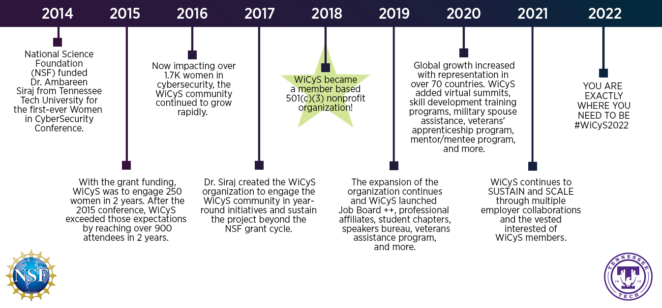

Slide 7
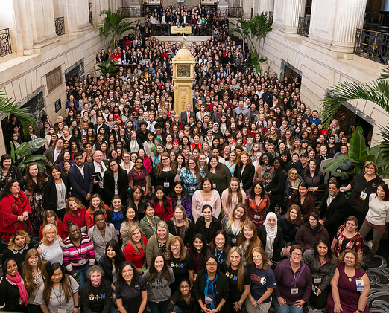

Slide 10
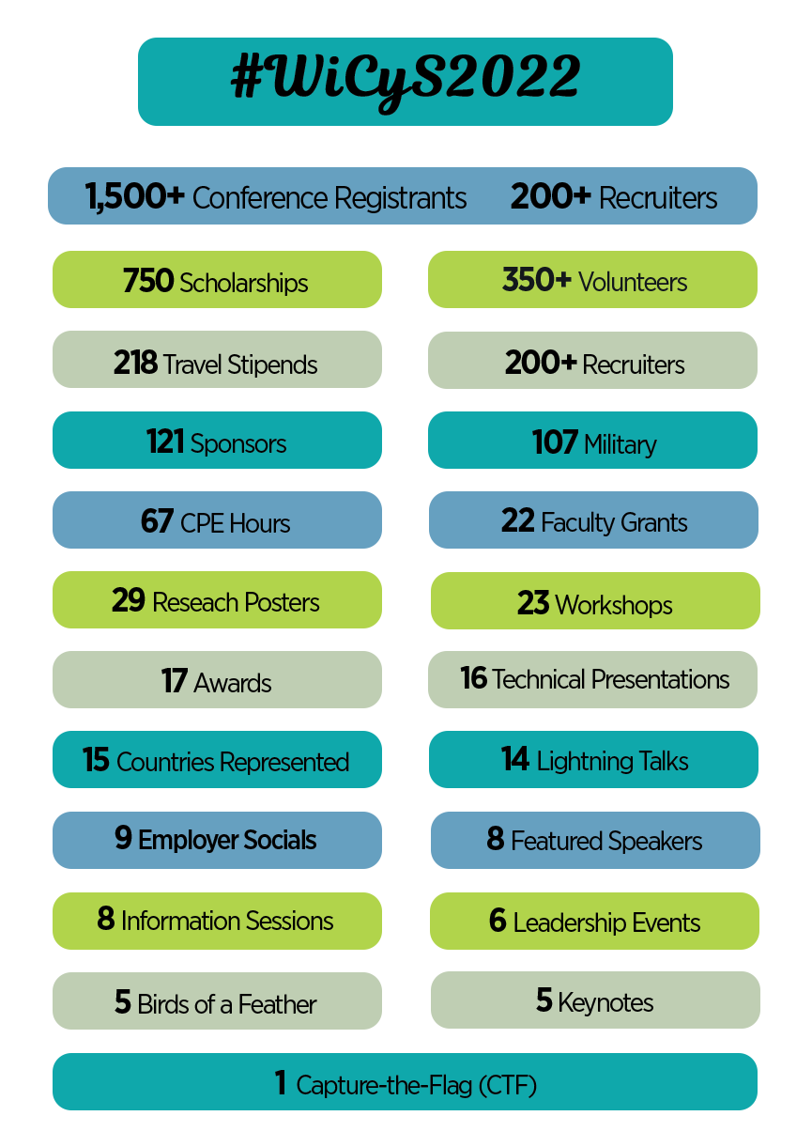

Slide 11
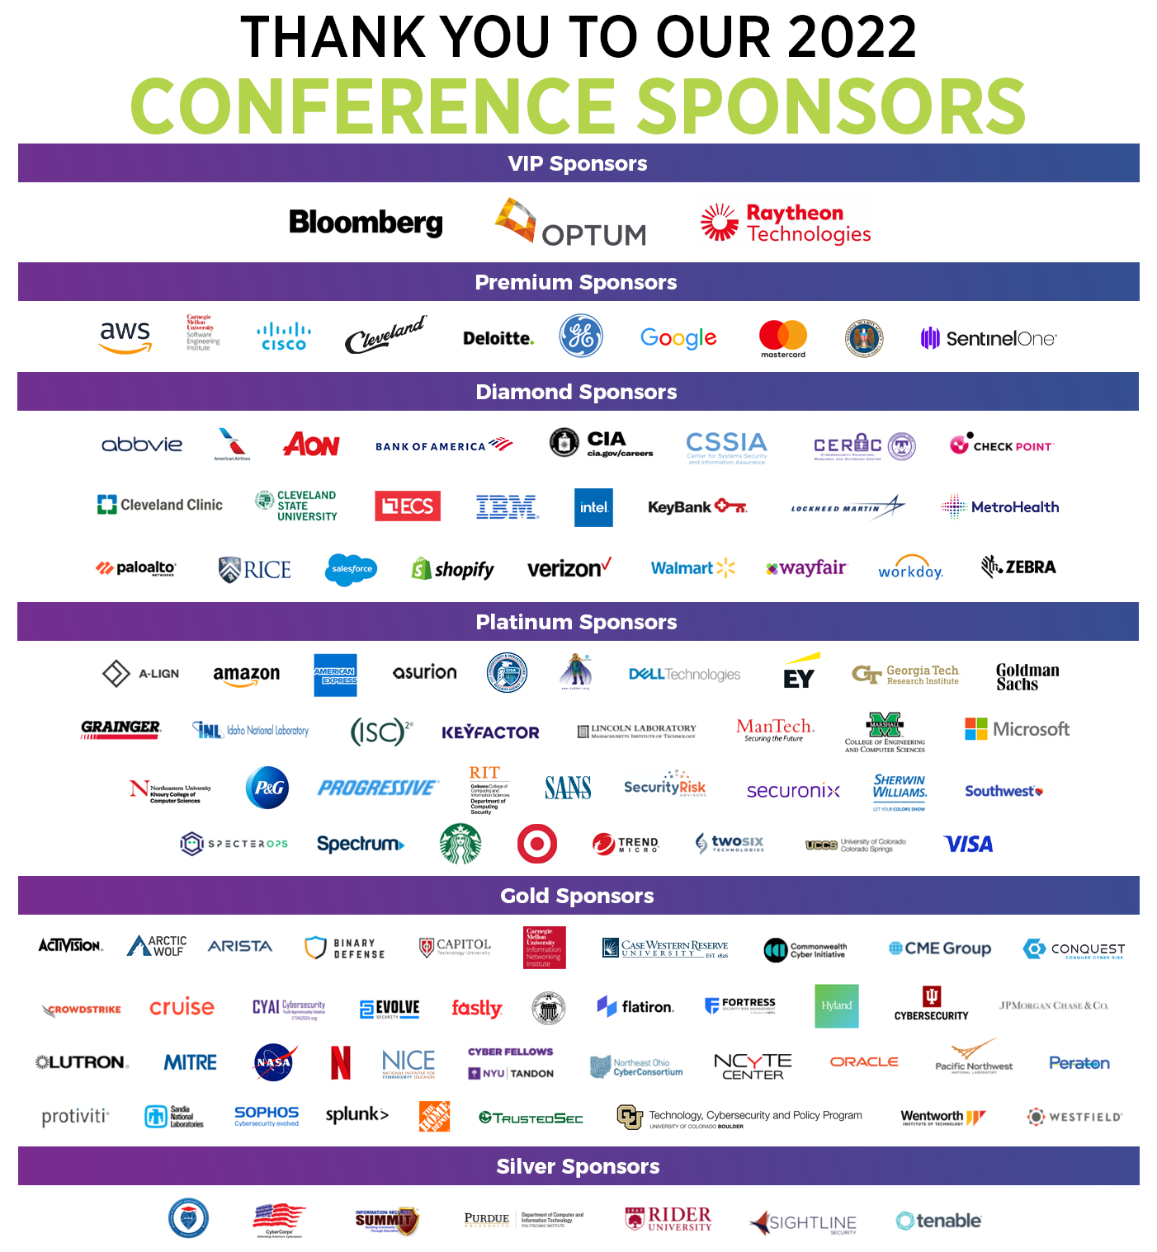

Slide 13
March 16-18, 2023
Student Scholarship, Faculty Lodging Grants, and Fellowship Award applications open in August/Sept ‘22
Call for Participation and Poster Sessions in August/Sept ‘22

Slide 15
WiCyS MISSION: Help build a strong gender-diverse cybersecurity workforce by facilitating… RECRUITMENT RETENTION ADVANCEMENT for women in the field

Slide 19
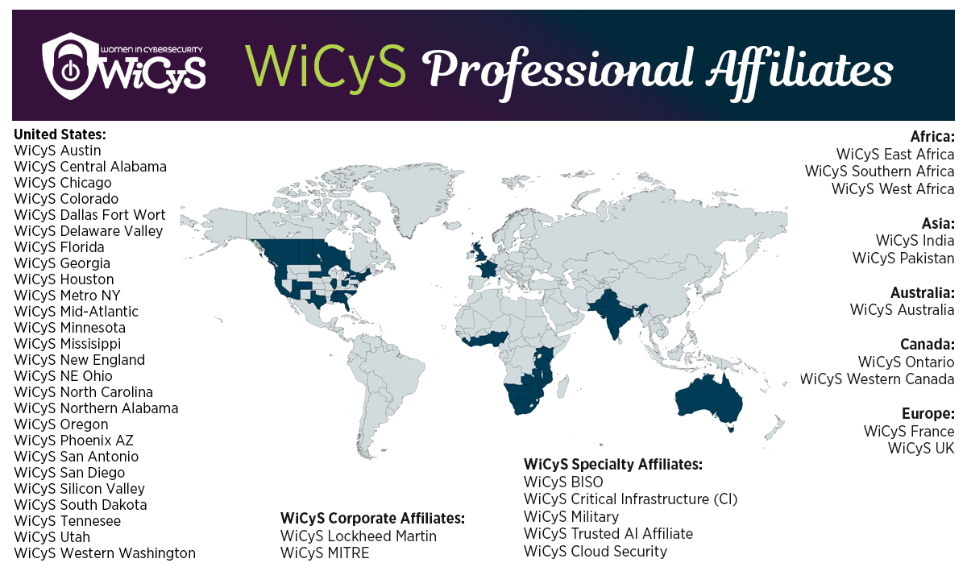

Slide 21
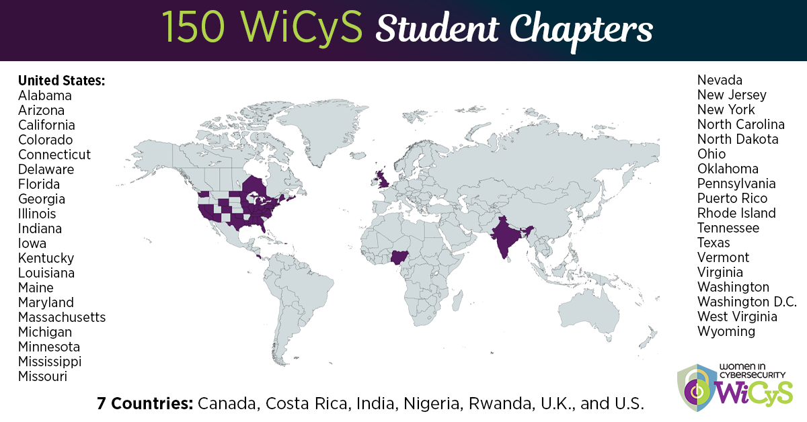

Slide 22
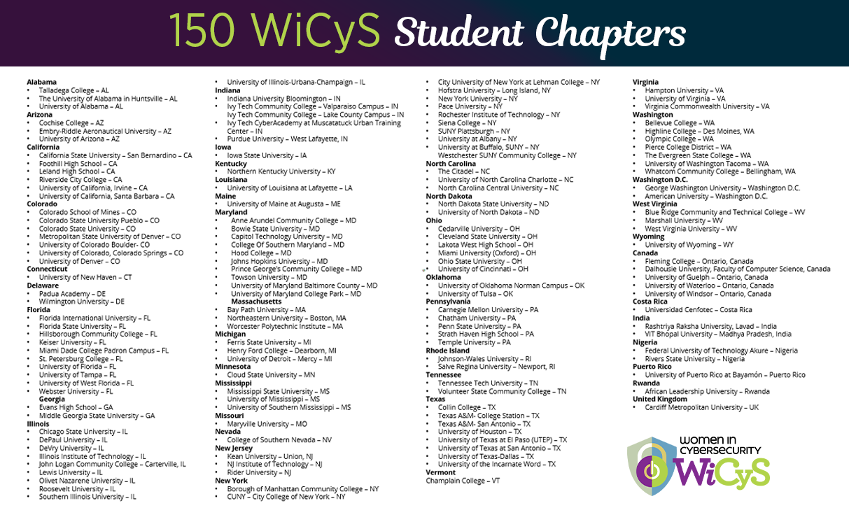

Slide 24
Applications Open: Summer 2022

Slide 25
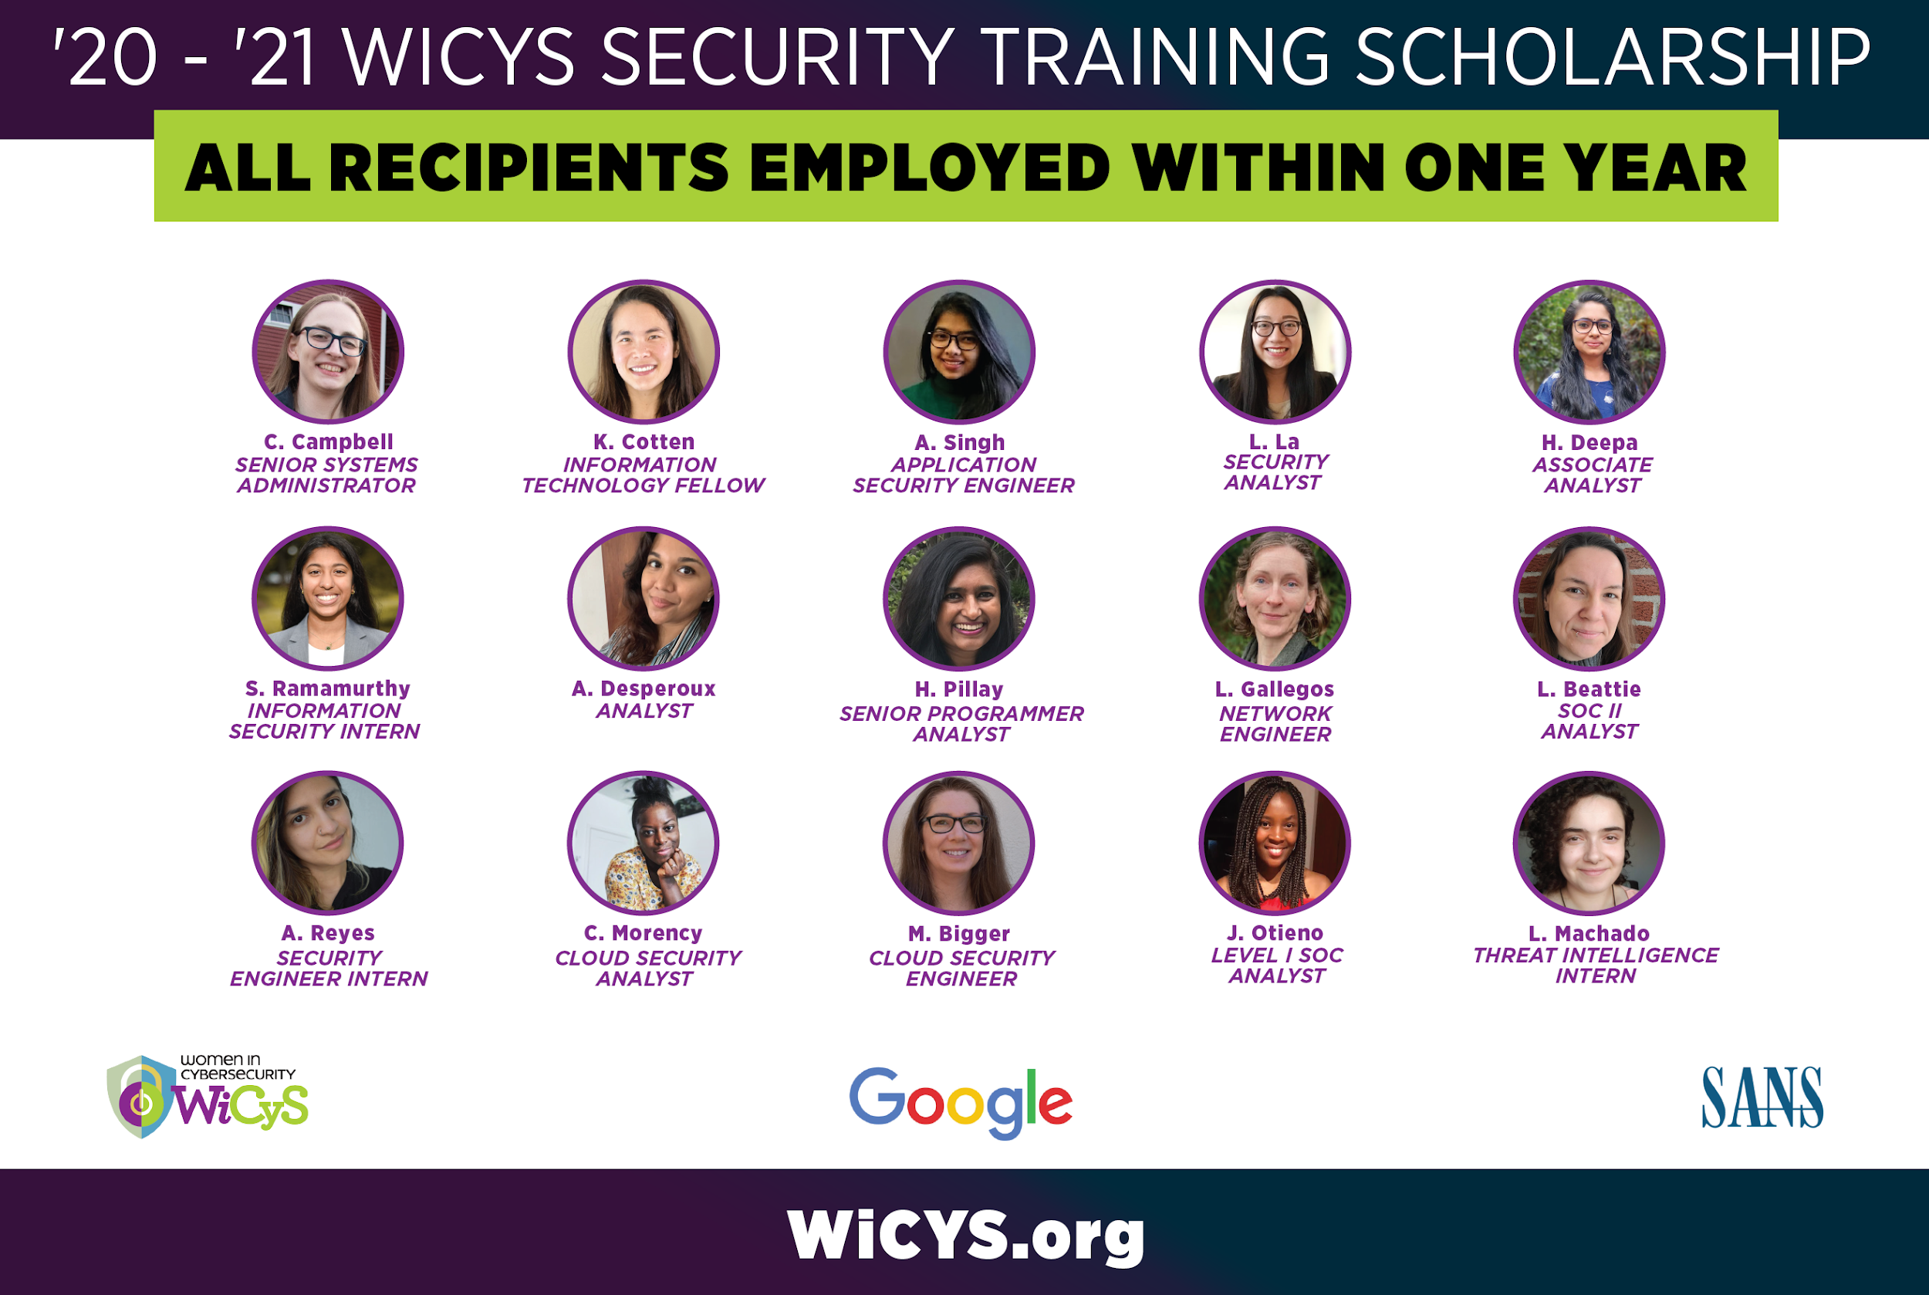

Slide 28
Website Views: 25K+
Applicants: 1.6K+
Final Recipients of
Advanced Certifications: 55

Slide 29
Applications Open for all WiCyS Members
(prioritizing veterans and military spouses)
SUMMER 2022

Slide 32
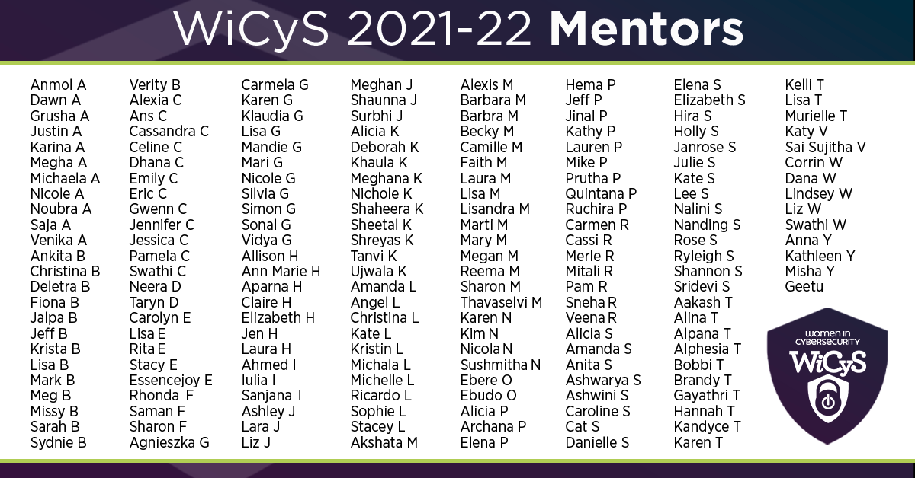

Slide 33
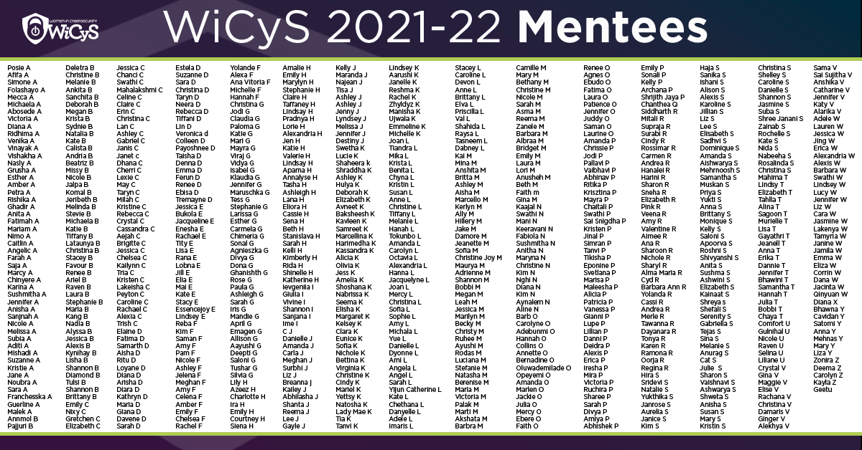

Slide 34
Pilot Program:
320 applicants, 235 assessments,
9 open roles, 29 shortlisted
Applications Open: Summer 2022

Slide 36
COHORT Enrollments: 500 Participants
Cyber FastTrack Participants: 171
Notes:
500

Slide 37
Community Colleges Request Funding
until July 8, 2022

Slide 39
WiCyS Contributions: $70K in support
Funding: 62 grants, $37,138 awarded

Slide 40
As of April 2022:
Resumes: 8oo+
Strategic Partners: 52

Slide 43
Tier 1: 723 Registrants
Website Views: 6,942
News Release Reach: 77M potential audience, 94 total pickup, 812 total engagement actions

Slide 44
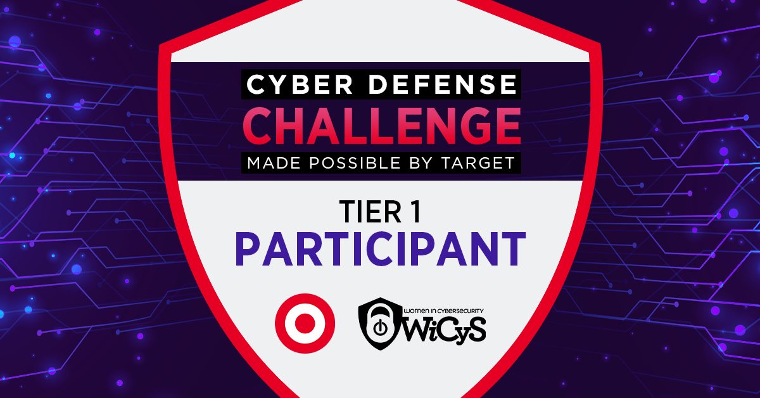

Slide 47
And as one woman rises, let’s give the grace and space for others to rise as well!

Slide 48
21K+ Newsletter Subscribers
16K+
Webinar Subscribers
44
Affiliates
38.9K+
17.1K+
150
Student Chapters
8.1K+
5.6K+
Members
5.7K+
5.3K+

Slide 49
lynn@wicys.org
TWITTER: @lynn_dohm
wicys.org

