Slide 1
Women in CyberSecurity (WiCyS)
Global Nonprofit Organization
www.wicys.org

Slide 3
5.6K+
members

Slide 4
2014 vs. 2022
2022
2014
3.5 Million
Unfilled Cybersecurity Roles
1 Million
24%
11%
Unfilled Cybersecurity Roles
Women in cybersecurity
Women in cybersecurity
*Frost and Sullivan, 2013
*Cybersecurity Ventures
*(ISC)2, 2019
*Cybersecurity Ventures

Slide 6
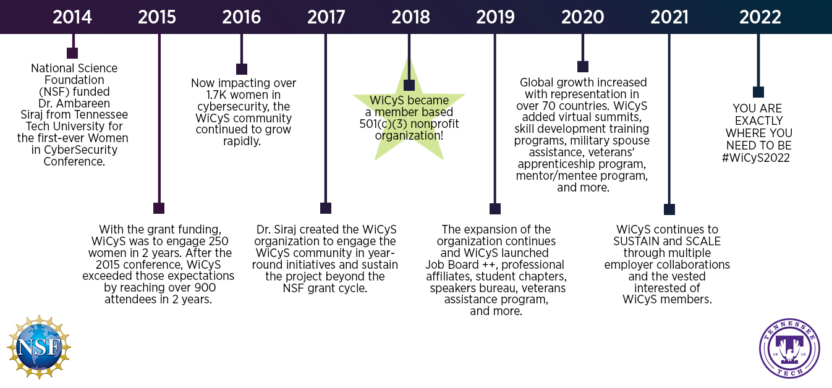

Slide 7
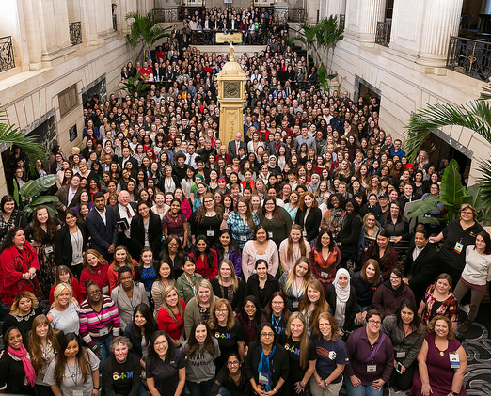

Slide 10
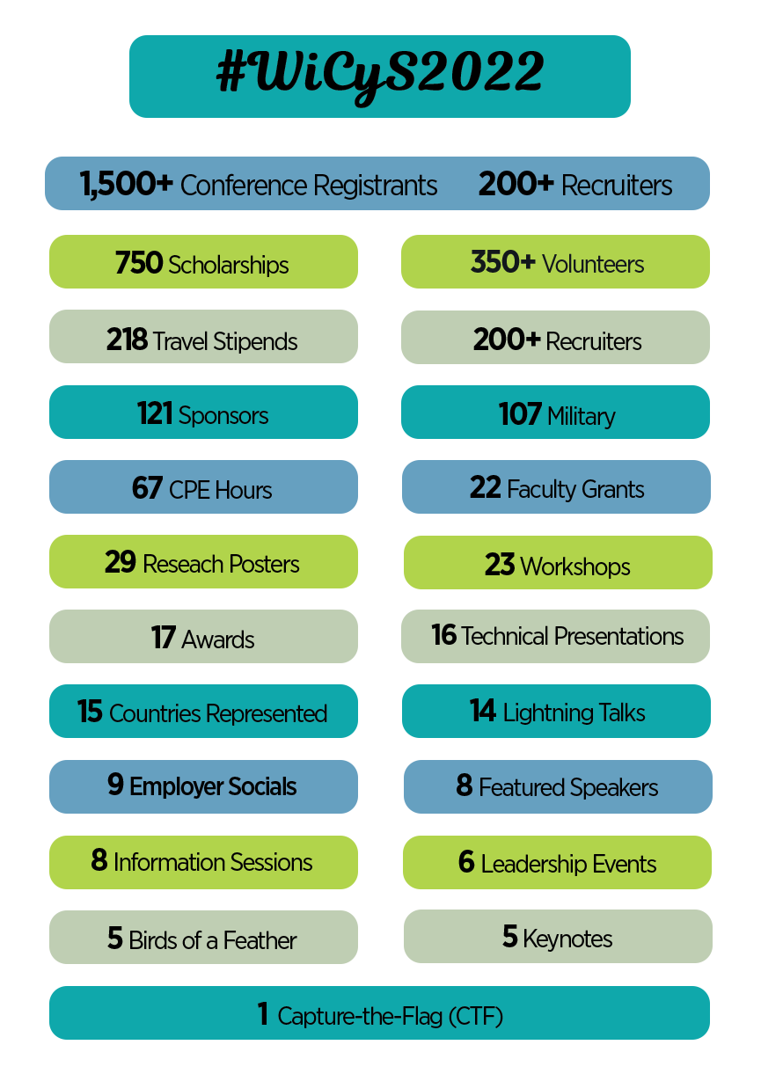

Slide 11
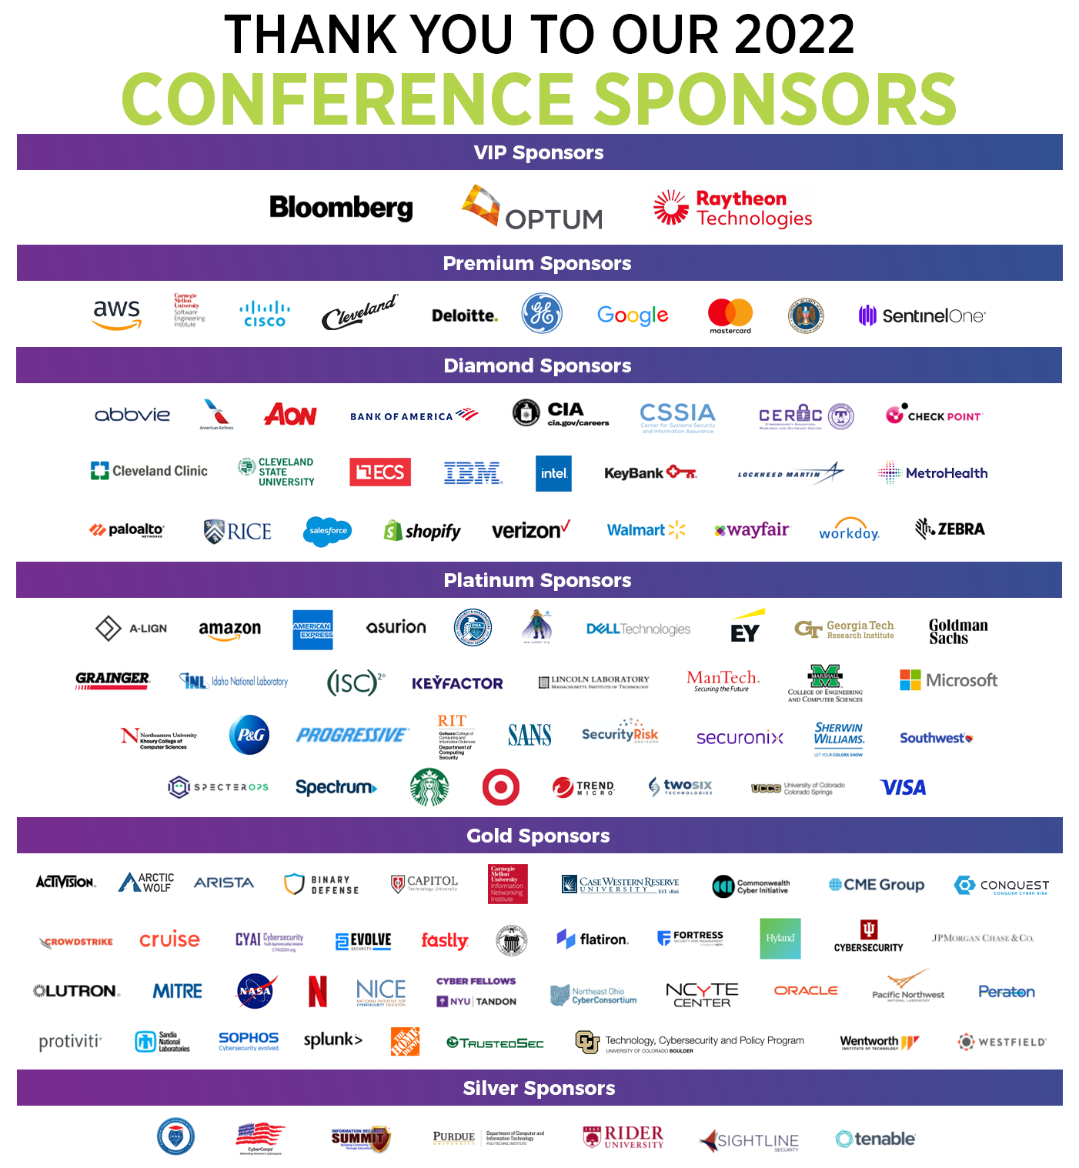

Slide 13
March 16-18, 2023
Student Scholarship, Faculty Lodging Grants, and Fellowship Award applications open in August/Sept ‘22
Call for Participation and Poster Sessions in August/Sept ‘22

Slide 15
WiCyS MISSION: Help build a strong gender-diverse cybersecurity workforce by facilitating… RECRUITMENT RETENTION ADVANCEMENT for women in the field

Slide 18
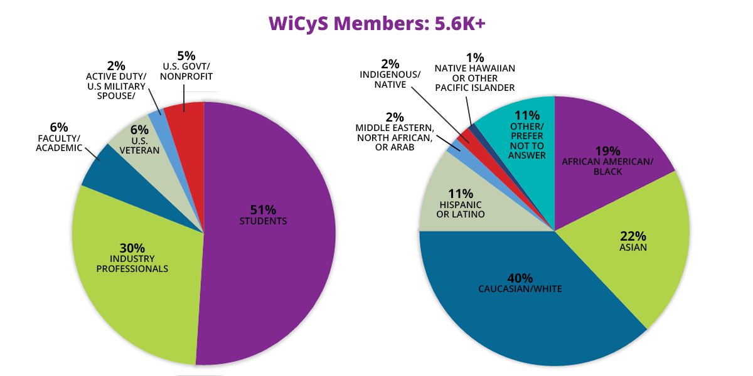

Slide 19
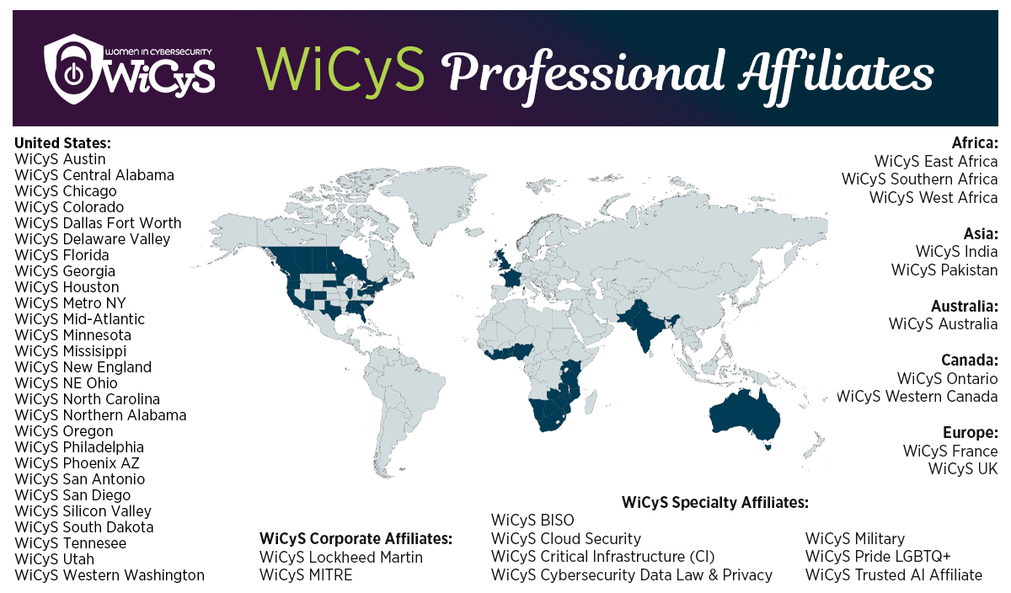

Slide 21
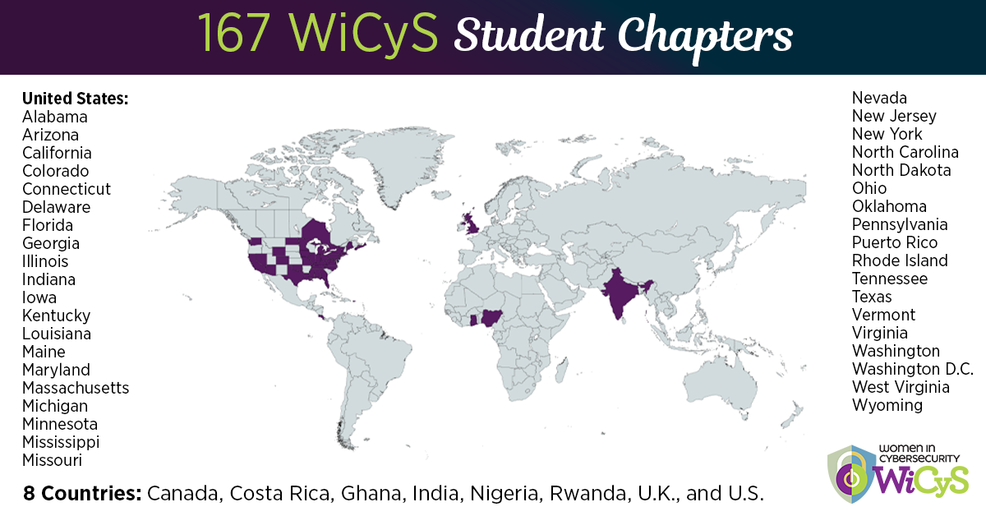

Slide 22
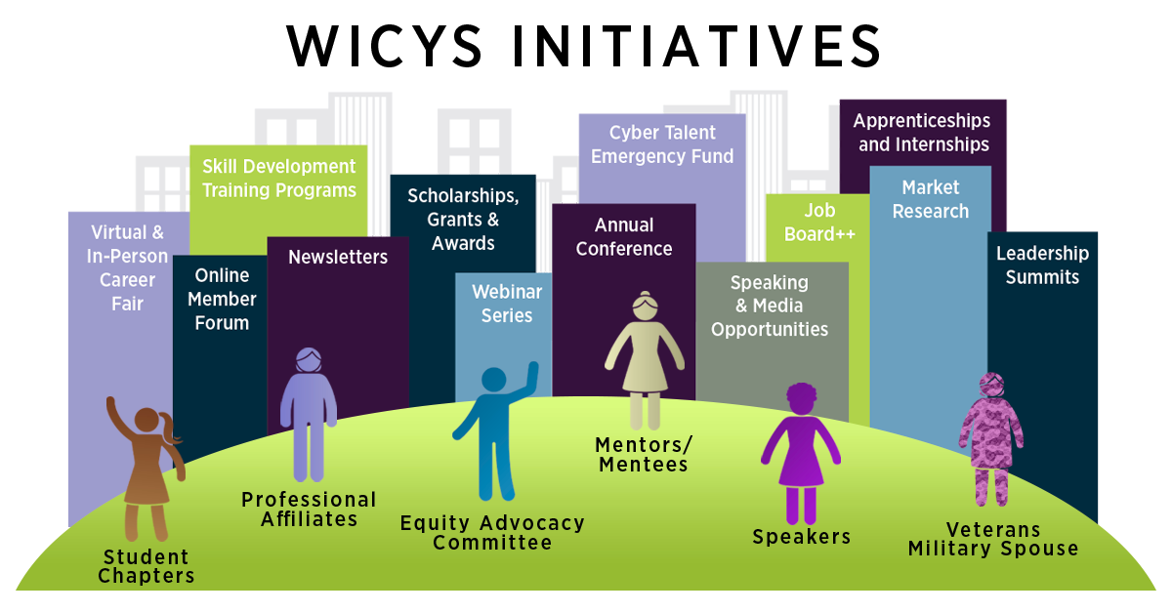

Slide 23
Applications Open: July 20, 2022

Slide 24
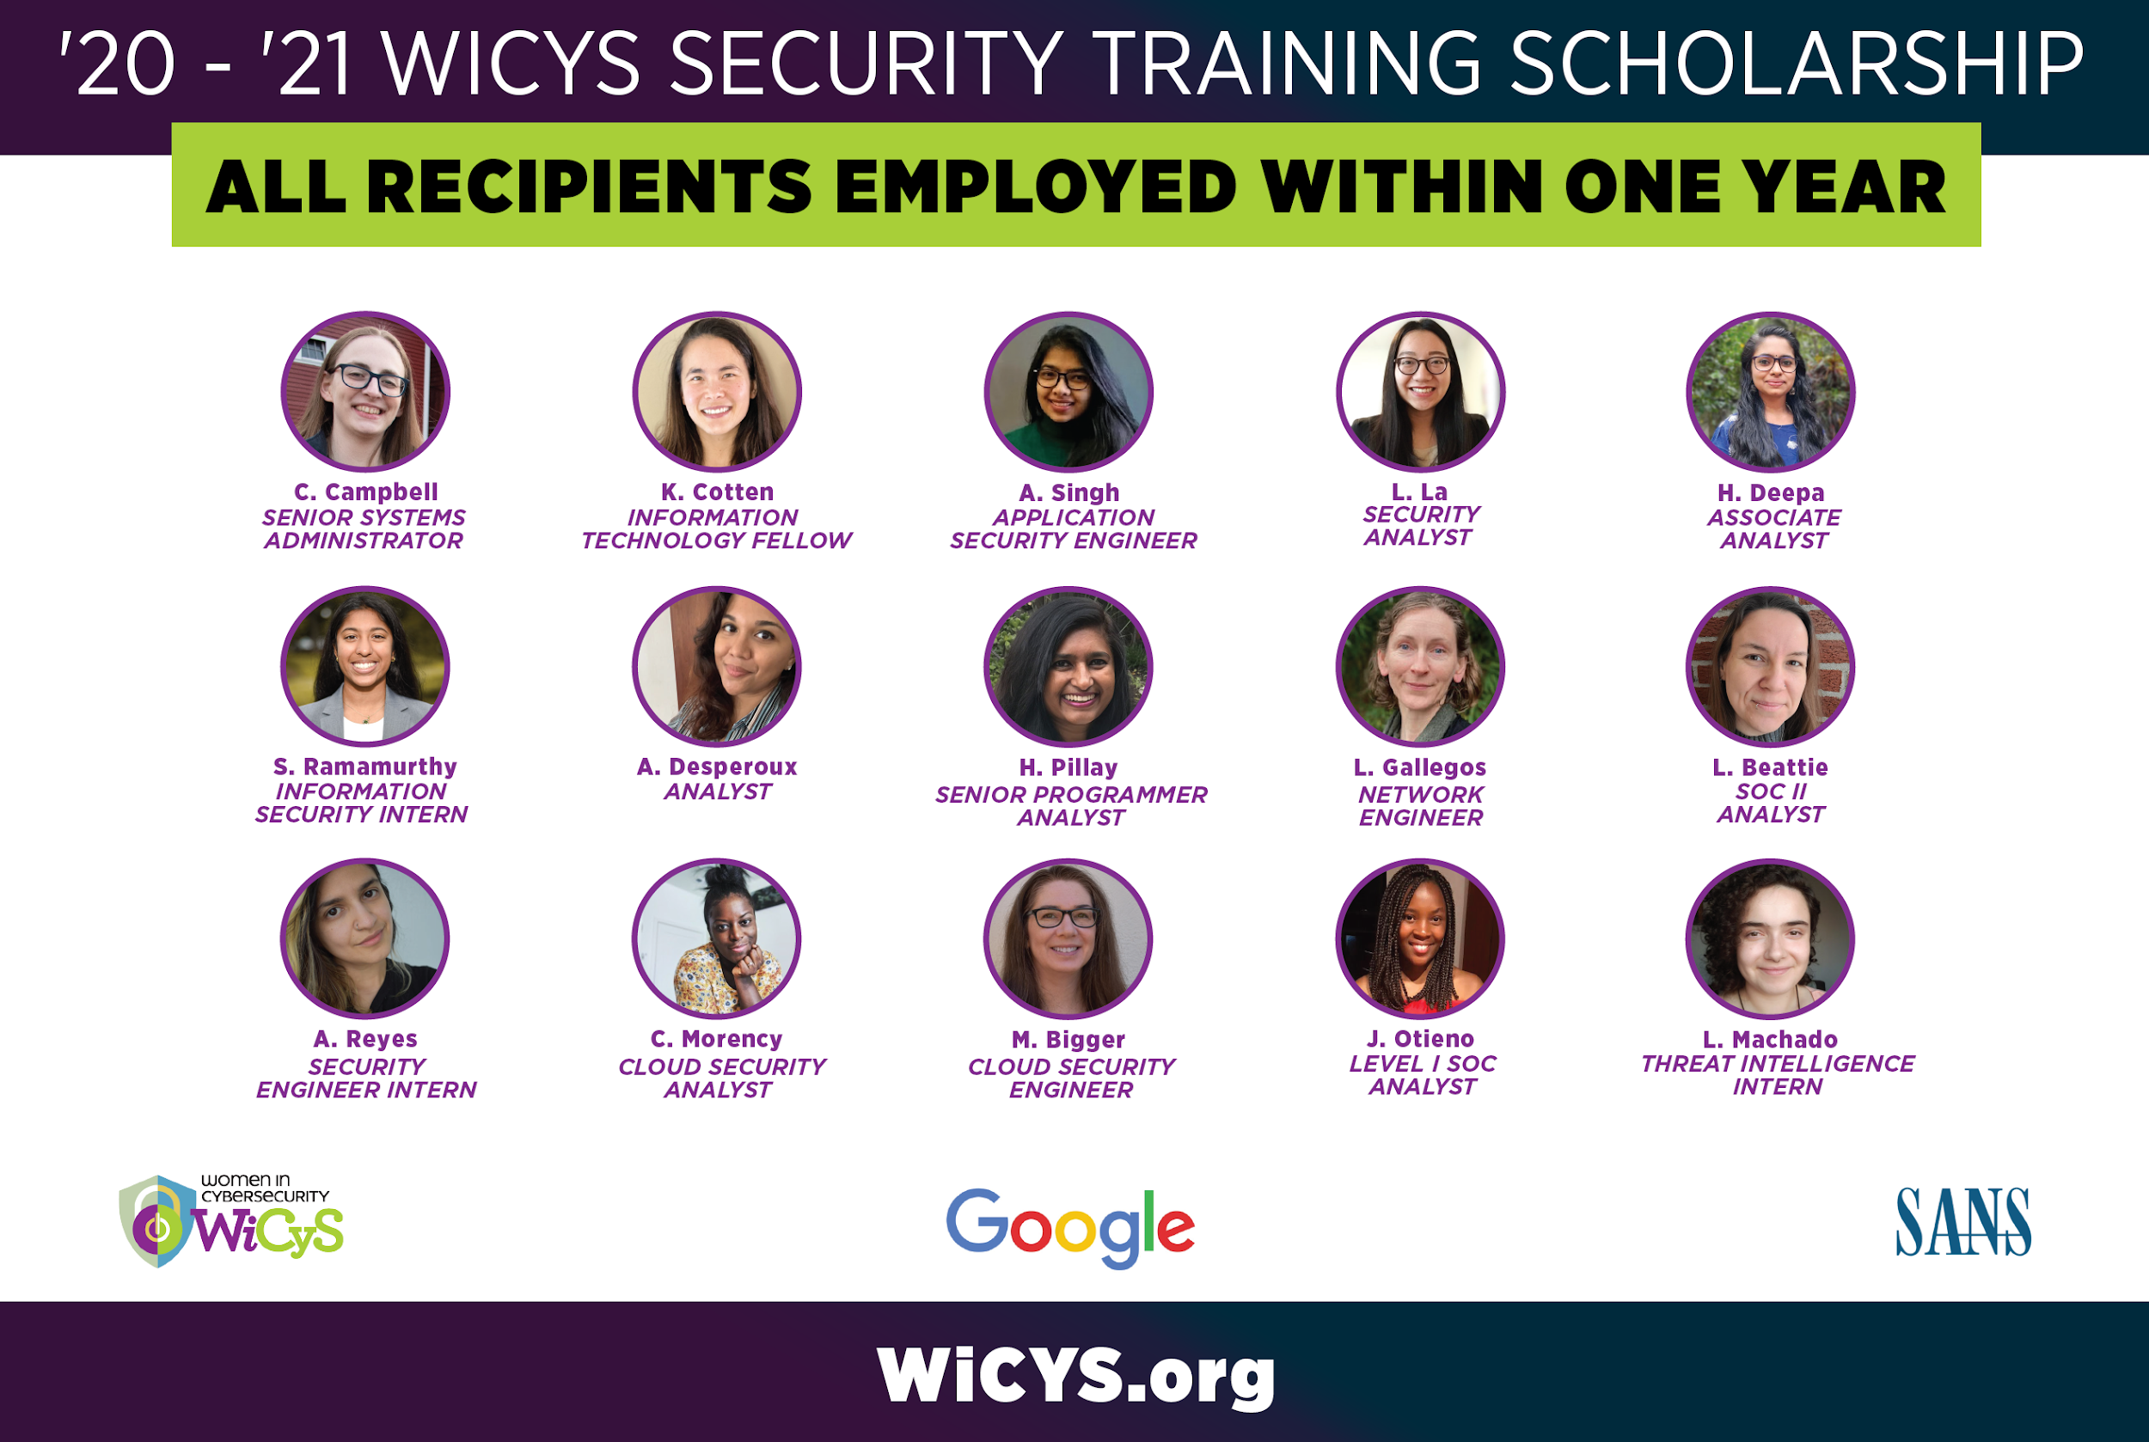

Slide 25
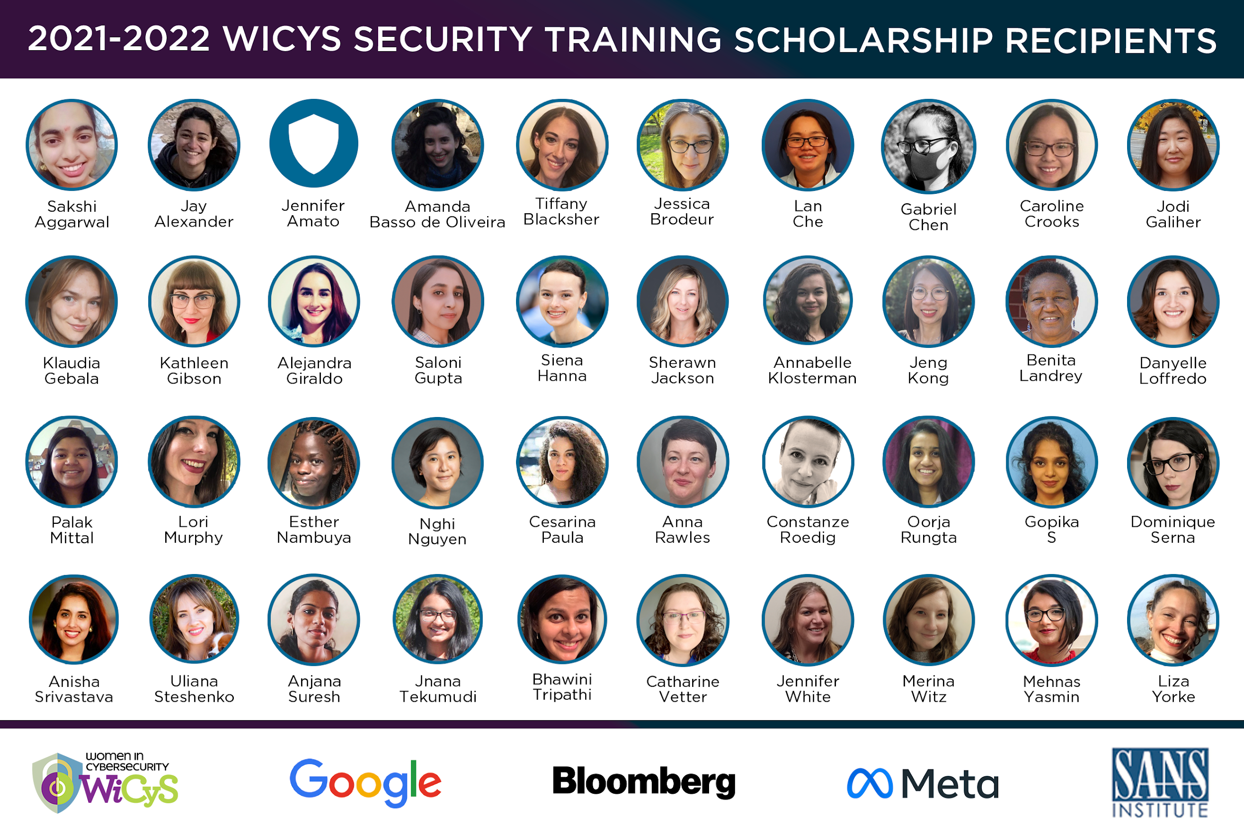

Slide 27
Website Views: 25K+
Applicants: 1.6K+
Final Recipients of
Advanced Certifications: 55

Slide 28
Applications Open for all WiCyS Members
(prioritizing veterans and military spouses)
SUMMER 2022

Slide 29
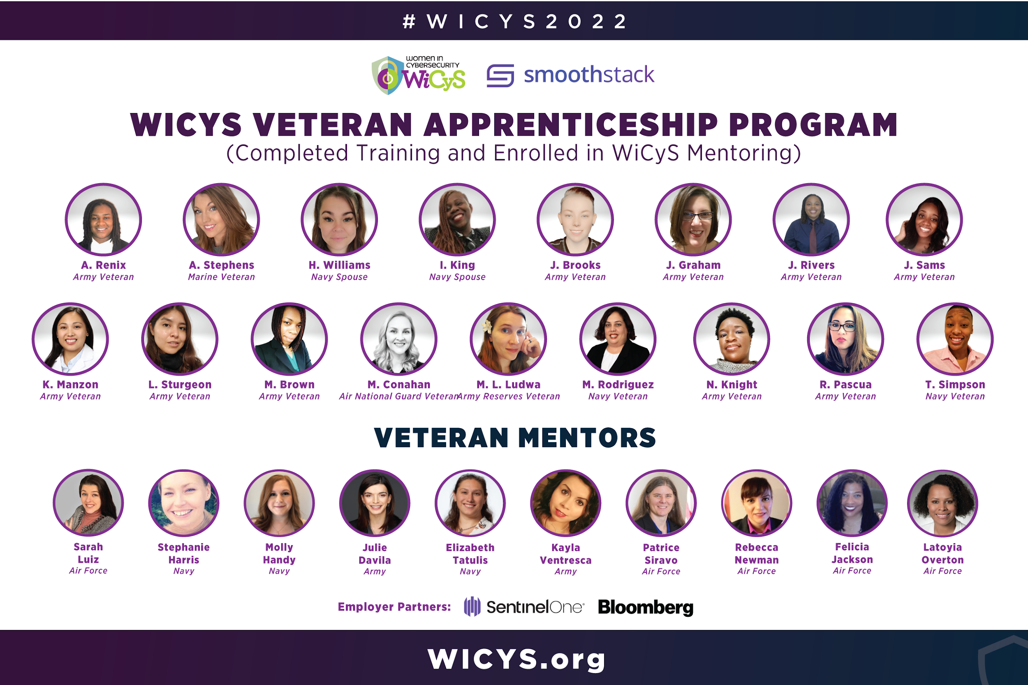

Slide 31
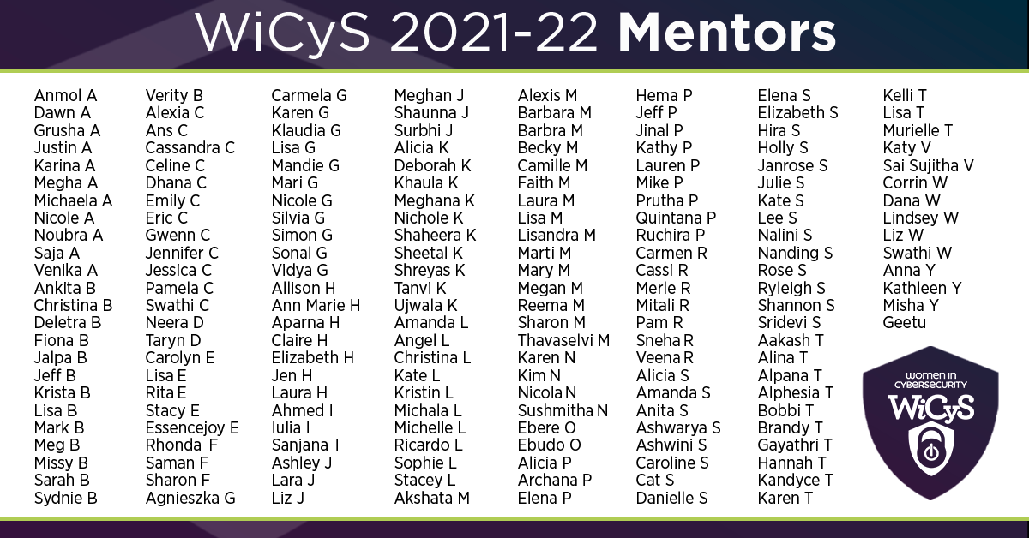

Slide 32
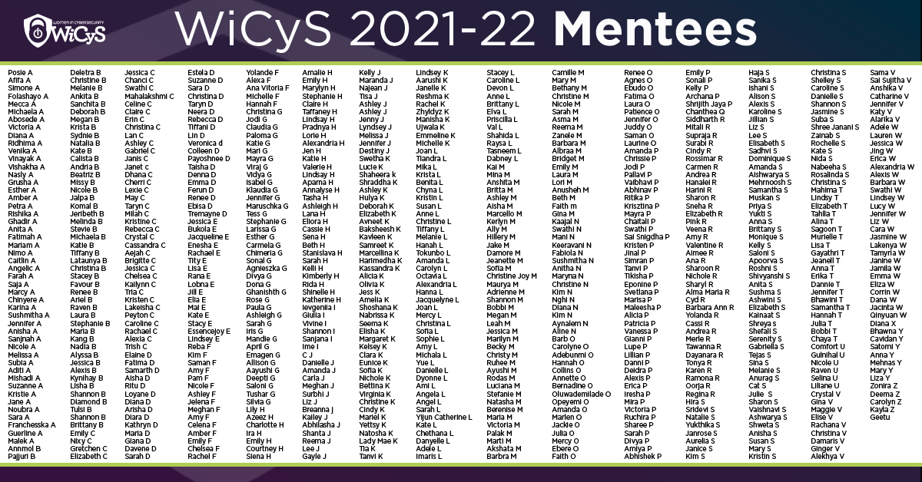

Slide 33
Pilot Program:
320 applicants, 235 assessments,
9 open roles, 29 shortlisted
Partners commit: August 3
Applications Open: August 24 – September 7

Slide 35
COHORT Enrollments: 500 Participants
Cyber FastTrack Participants: 171
Notes:
500

Slide 36
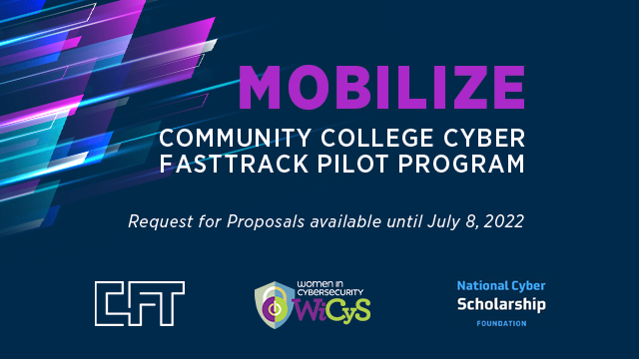
Community Colleges Request Funding
until July 8, 2022

Slide 38
WiCyS Contributions: $70K in support
Funding: 62 grants, $37,138 awarded

Slide 39
As of May 2022:
Resumes: 853+
Strategic Partners: 57

Slide 42
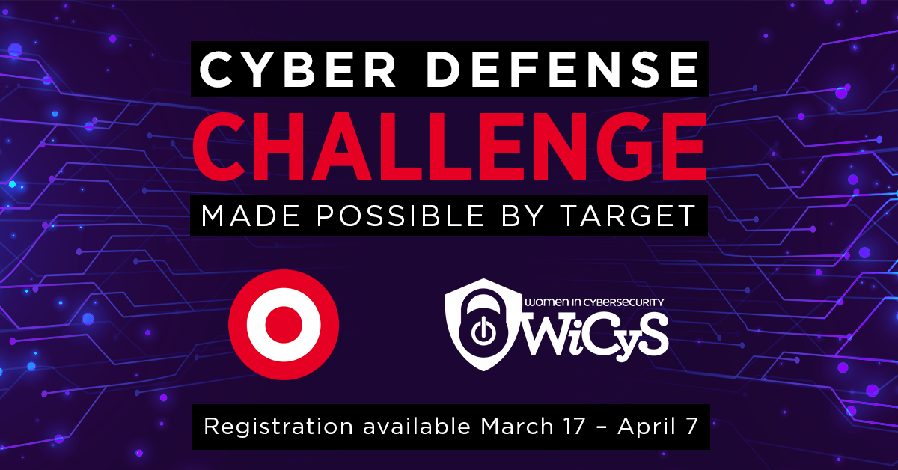
Tier 1: 723 Registrants
Website Views: 6,942
News Release Reach: 77M potential audience, 94 total pickup, 812 total engagement actions

Slide 43
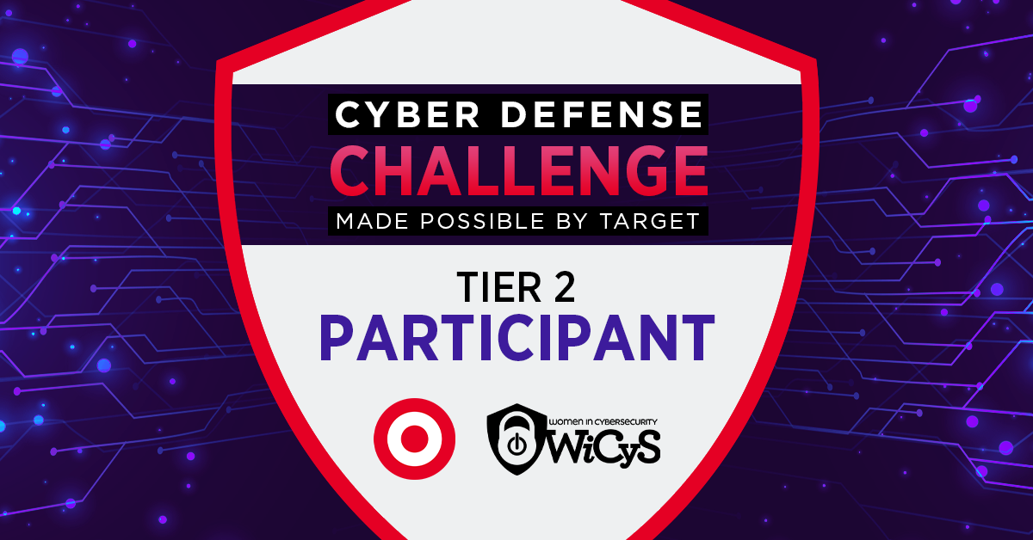
Tier 2: 37 participants

Slide 46
And as one woman rises, let’s give the grace and space for others to rise as well!

Slide 47
21K+ Newsletter Subscribers
18K+
Webinar Subscribers
46
Affiliates
41.8K+
17.9K+
167
Student Chapters
8.4K+
5.6K+
Members
5.8K+
5.5K+

Slide 48
lynn@wicys.org
TWITTER: @lynn_dohm
wicys.org

