Slide 1
Haystack + WiCyS
11 July 2023

Slide 2
Overview
Team
Summary statistics
Score distribution
Clustering
Questions

Slide 3
Team
Dr. Mike Bunting
James Hull
Doug Britton

Slide 4
Summary Statistics
1484 invites sent
781 (53%) participants with some CyberGEN IQ data
553 (71% of those who started) completed tests

Slide 5
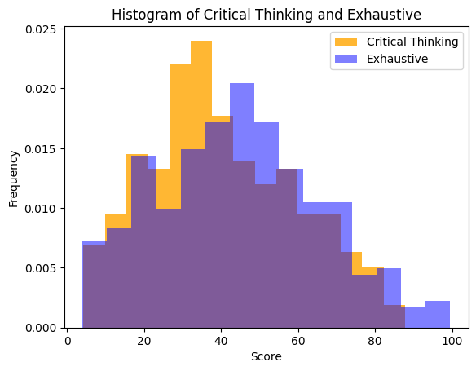
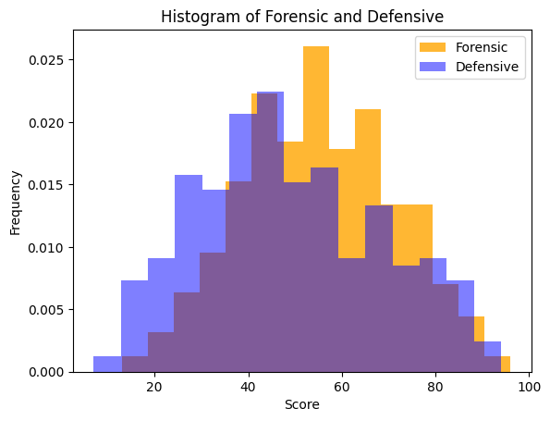
Score Distribution
Saw wide range of scores across participants that aligned with previous results

Slide 6
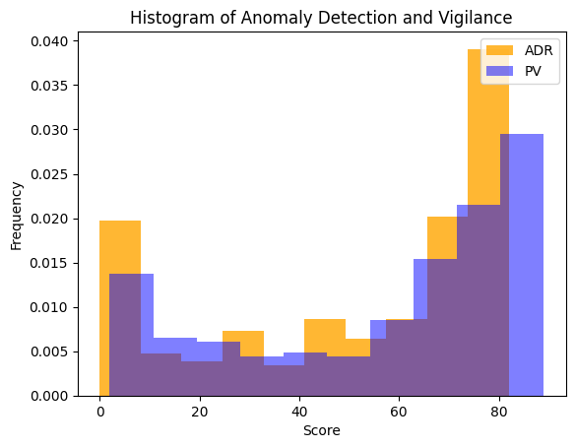
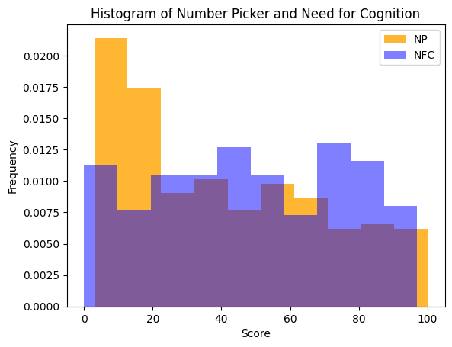
Score Distribution
Really strong vigilance scores (rare!) and anomaly detection
Fairly flat Number Picker (risk aversion) with skew towards risk averse
Varied need for cognition scores - often a strong indicator of course performance

Slide 7
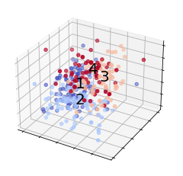
Clustering
Have found success in the past clustering participants, especially when team building
Data supported four clusters, although the group was more diverse (less clumpy) than most

Slide 8
Clustering
Cluster 1 (32%):
Lowest performing cluster, but scored well on Exhaustive tasks
Cluster 2 (26%):
Mid range performers across all tasks
Cluster 3 (23%):
High performers. Very strong on Responding tasks
Cluster 4 (19%):
Comparable with High Performers in Critical Thinking, but struggled on Real Time tasks. Highest scores in Initiating

Slide 9
So What?
CyberGEN IQ is able to differentiate participants across a variety of cognitive abilities and preferences
Can cluster participants by cognitive similarity
With quantitative or qualitative feedback, can start to predict future success
After understanding which cognitive abilities are valuable, can build pre-screen test, set thresholds, identify individuals likely to be elite candidates

Slide 10
Report Review

Slide 11
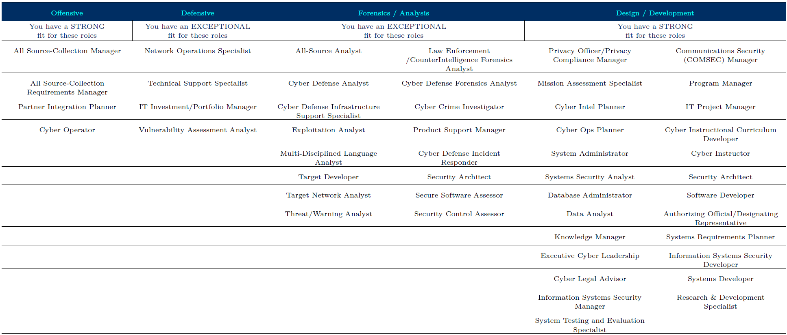
Quadrant Mapping to NICE/NIST Roles

Slide 12
Questions
During the review, I would appreciate an explanation of how the percentiles translate for each of the individual tasks/construct; that is, what does it mean to be the top, middle, bottom percentile for each task and what do those ranges mean by construct?
Based on the results, does it mean I absolutely cannot do well in offensive and defensive security?

