Slide 1
Haystack Solutions
A Cybersecurity Talent Development Company

Slide 2
VADM (Ret) Jan Tighe
Former Commander, 10th Fleet Commander
Director, Goldman Sachs
Advisor, Haystack Solutions
“And we know there are different types of aptitude. Some people
are comfortable as technology users, and some people are
comfortable and curious about how far they can take this. Those
are the people we want to slot into the higher-end areas,” she said.
“We have a defense language aptitude battery that helps us figure
out who's going to be good at languages. Where's our aptitude
test for cyber?

Slide 3
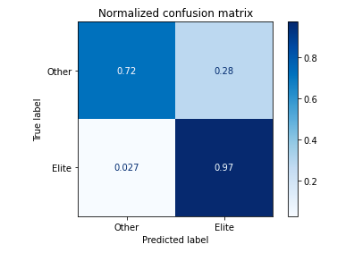
Case Study: Selecting US Air Force
Cyber Warfare Operators
USAF conducted an extensive study of the ability to use CyberGEN.IQ as a filter for students coming into Cyber Warfare Operator training.
CyberGEN.IQ was 97% effective at predicting who was going to become elite (score 90% or higher) Cyber Warfare Operators
CyberGEN.IQ was 84% effective at predicting who would be Cyber Warfare Operators vs other IT professionals

Slide 4
Case Study: Selecting Special Operations Command Cyber Teams
US Special Operations Command (SOCOM) is utilizing CyberGEN.IQ to pre-screen applicants for a cyber operations program
CyberGEN.IQ was 77% effective in predicting who would pass/fail the SOCOM selection event
Different clusters of cognitive ability for teams became clear:
Mentally Tough
Creative Thinkers
Critical Thinkers

Slide 5
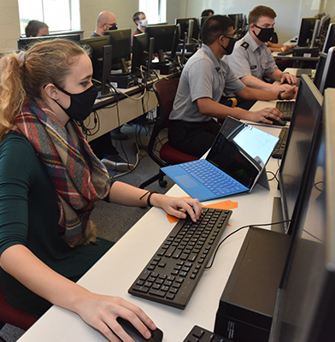
Case Study: University of North Georgia
Haystack Solutions helped the University of North Georgia (UNG) to literally find "students in the haystack" with no prior cybersecurity knowledge, skills or abilities, creating a diverse team that won the NSA Codebreaker Challenge in 2019 and 2020.
This winning team increased the percentage of women on the team from 10% to 20%, while increasing the overall size of the team by 4x. Of those women:
Most never studied cyber or software development
Now nationally competitive
Many considering cyber careers
Many have stayed in the studies for more than 2 years now
CyberGEN.IQ encouraged them, because it wasn’t intimidating

Slide 6
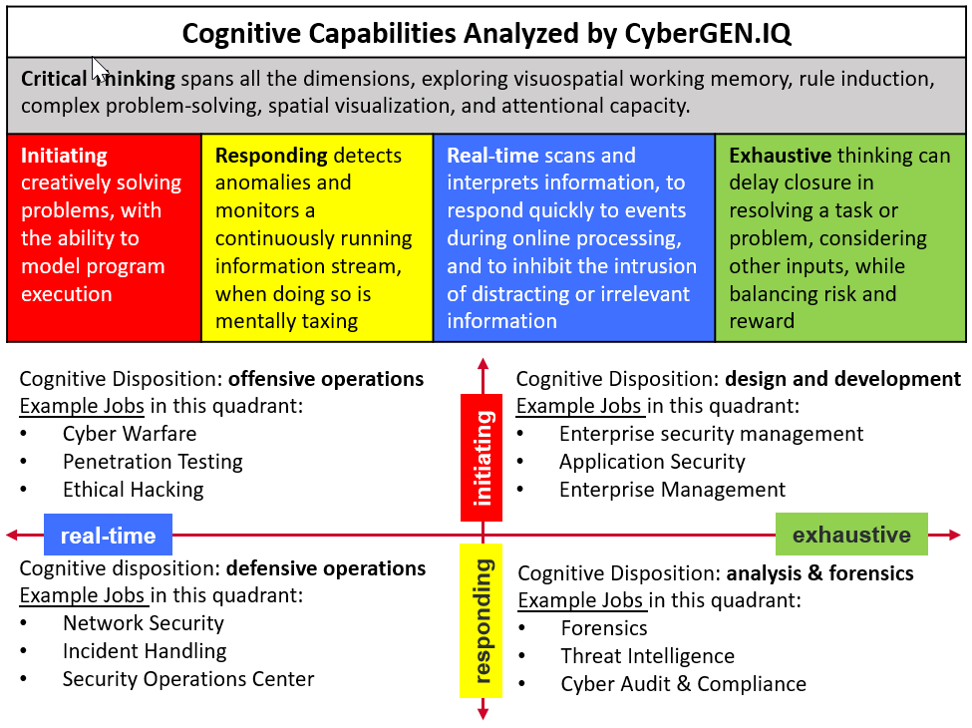
CyberGEN.IQ Cognitive Overview
Cognitive Assessment | Short Name | Dimension
Need for Cognition | NFC | Critical Thinking
Dynamic Systems Control | DSCB | Critical Thinking
Matrix Reasoning | MRC | Critical Thinking
Paper Folding | PFB | Critical Thinking
Remember and Count | RACA | Critical Thinking
Remote Associates | RATA | Initiating
Spatial Integration | SRIA | Initiating
Coding Speed | CSB | Responding
Pattern Vigilance | PVA | Responding
Anomaly Detection Rule Based | ADRA | Responding
Statistical Learning | SLB | Responding
Recent Probes - 1 item | RP1A | Real-Time
Recent Probes - 4 items | RP4A | Real-Time
Need for Cognitive Closure | NFCC | Exhaustive
Number Picker | NPA | Exhaustive

Slide 7
CyberGEN.IQ 15 Tests within the Assessment Battery
Definition of the construct - The Anomaly Detection Rule-Based (ADR) task measures the construct of anomaly detection, in the Responsive Thinking construct category. Anomaly detection represents the ability to detect information that is anomalous in a larger context, such that it does not conform to the expected pattern. ADR specifically assesses this ability by having examinees explicitly learn the rules that govern a system, and then detect patterns in the system that break these rules.
Cognitive Assessment | Short Name | Dimension
Need for Cognition | NFC | Critical Thinking
Dynamic Systems Control | DSCB | Critical Thinking
Matrix Reasoning | MRC | Critical Thinking
Paper Folding | PFB | Critical Thinking
Remember and Count | RACA | Critical Thinking
Remote Associates | RATA | Initiating
Spatial Integration | SRIA | Initiating
Coding Speed | CSB | Responding
Pattern Vigilance | PVA | Responding
Anomaly Detection Rule Based | ADRA | Responding
Statistical Learning | SLB | Responding
Recent Probes - 1 item | RP1A | Real-Time
Recent Probes - 4 items | RP4A | Real-Time
Need for Cognitive Closure | NFCC | Exhaustive
Number Picker | NPA | Exhaustive

Slide 8
CyberGEN.IQ 15 Tests within the Assessment Battery
Cognitive Assessment | Short Name | Dimension
Need for Cognition | NFC | Critical Thinking
Dynamic Systems Control | DSCB | Critical Thinking
Matrix Reasoning | MRC | Critical Thinking
Paper Folding | PFB | Critical Thinking
Remember and Count | RACA | Critical Thinking
Remote Associates | RATA | Initiating
Spatial Integration | SRIA | Initiating
Coding Speed | CSB | Responding
Pattern Vigilance | PVA | Responding
Anomaly Detection Rule Based | ADRA | Responding
Statistical Learning | SLB | Responding
Recent Probes - 1 item | RP1A | Real-Time
Recent Probes - 4 items | RP4A | Real-Time
Need for Cognitive Closure | NFCC | Exhaustive
Number Picker | NPA | Exhaustive
Definition of the construct - The Coding Speed (CS) task measures the construct of pattern recognition and scanning, in the Responsive Thinking construct category. Pattern recognition and scanning represents the ability to scan, detect patterns in, and react quickly to incoming information. CS specifically assesses this ability by having examinees quickly form associations between numbers and symbols, and then correctly represent those associations.

Slide 9
CyberGEN.IQ 15 Tests within the Assessment Battery
Cognitive Assessment | Short Name | Dimension
Need for Cognition | NFC | Critical Thinking
Dynamic Systems Control | DSCB | Critical Thinking
Matrix Reasoning | MRC | Critical Thinking
Paper Folding | PFB | Critical Thinking
Remember and Count | RACA | Critical Thinking
Remote Associates | RATA | Initiating
Spatial Integration | SRIA | Initiating
Coding Speed | CSB | Responding
Pattern Vigilance | PVA | Responding
Anomaly Detection Rule Based | ADRA | Responding
Statistical Learning | SLB | Responding
Recent Probes - 1 item | RP1A | Real-Time
Recent Probes - 4 items | RP4A | Real-Time
Need for Cognitive Closure | NFCC | Exhaustive
Number Picker | NPA | Exhaustive
Definition of the construct - The Paper Folding (PF) task measures the construct of spatial visualization, in the Critical Thinking construct category. Spatial visualization represents the ability to form and manipulate visuospatial representations. PF specifically assesses this ability by having examinees use their spatial visualization ability to determine where holes punched in folded pieces of paper would appear once the paper is unfolded

Slide 10
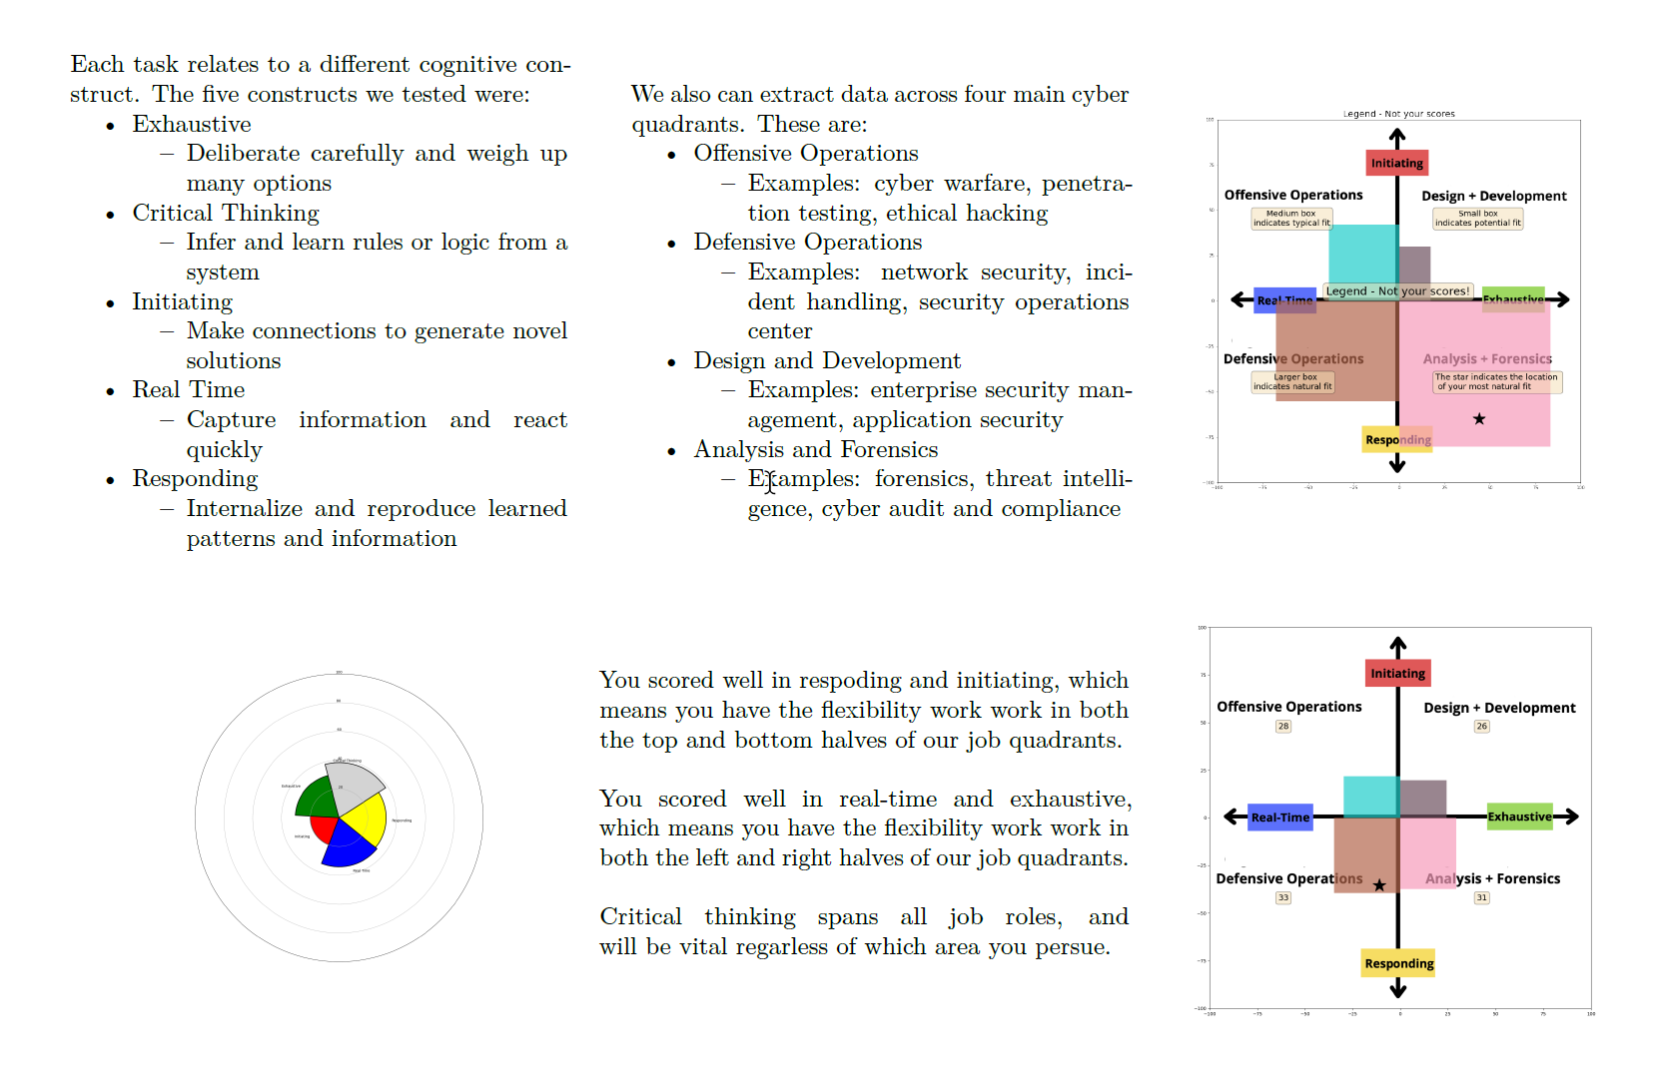
Sample Report

Slide 11
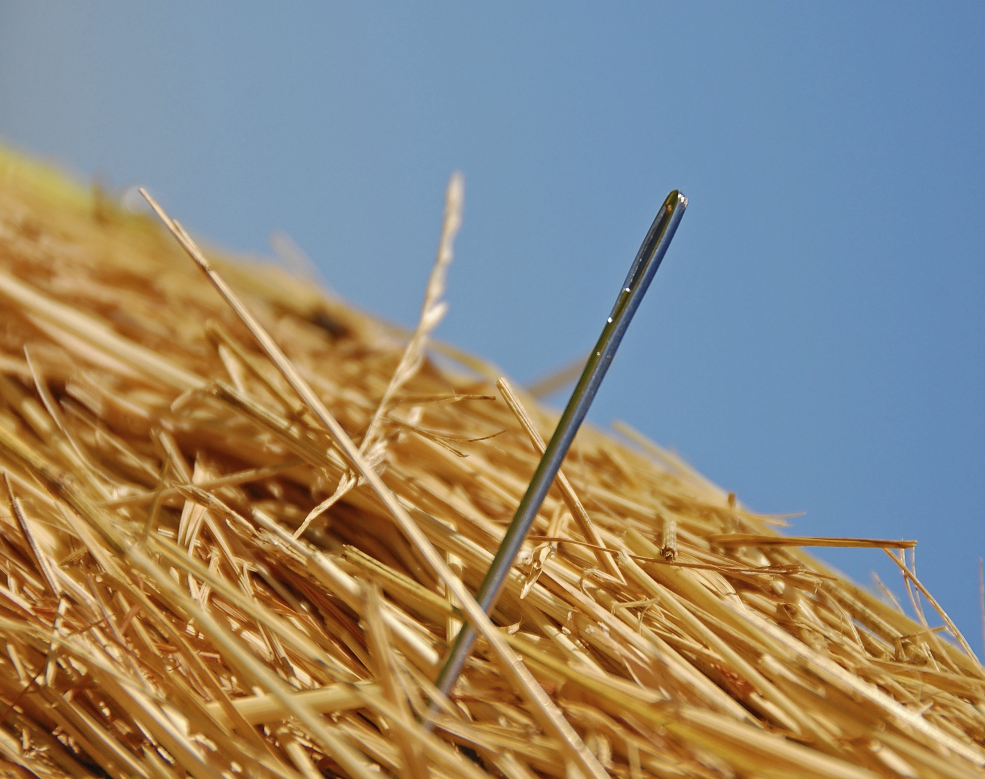
Doug Britton, CEO doug@haystacksolutions.com 571-250-5941

